Slide 1


BalanceIQ
Presented by
Abhinav Sharma
Kiruthickranjan K S

Slide 2

What is BalanceIQ:
BalanceIQ is a complete health tracking app that lets users log physical activity, meals, mood, and a personalized health metric daily in one place
This data helps users reflect on their habits and share it with doctors or therapists to track their overall progress.

Slide 3
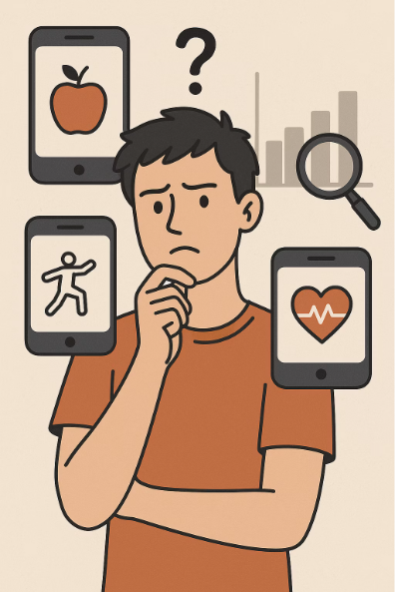
Why BalanceIQ?
Single-Focus Health Apps:
Most health apps concentrate on a single domain—whether diet, exercise, or mental well-being—rather than providing an integrated, holistic view of overall health.
Lack of Insights:
Without personalized analytics, users struggle to spot trends and make data-driven decisions about their health.

Slide 4
Key Features
Authentication API:
Secures user registration and login system.
Used JWT tokens for enhanced security.
Gateway API:
Used Ocelot to centralize routing and simplify communication between the microservices.
Health Metrics API
It offers a flexible way for users to track specific health metrics daily, based on their individual needs
Exercise API:
It lets users to log their physical activity, including type, duration and date of the workout.
Uses Nutritionix API to automatically calculate calories burned based on the activity.
Mental Health API
Allows users to log their moods, notes, and dates to track emotional wellbeing
It also has a meditation dashboard that helps user to practice meditation.
Diet Service API
Users can log meal types with date and time of consumption
User can enter food names, quantities and units to keep track of their daily nutrition.

Slide 5




User Workflow
Register & Profile Setup
Users register and set-uo personal profiles
Activity Logging
Log their physical activity , meals, mood and their health metrics
Auto Calorie Burn Calculation
System automatically calculates the Calories Burned based on the type of the activity and duration of the workout
Dashboard Access
Access the Dasboard to maintain the physical and the mental Health of the user

Slide 6
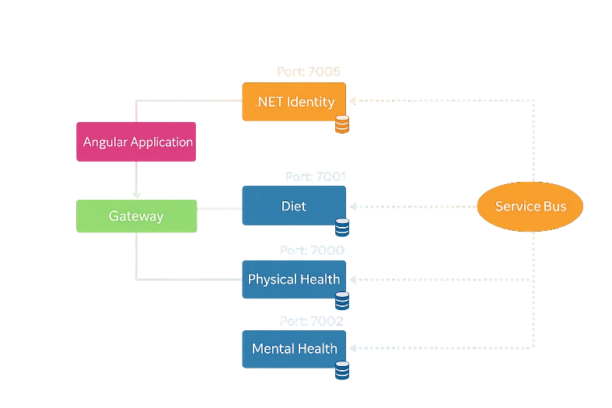
System Architecture
Port: 7777

Slide 7
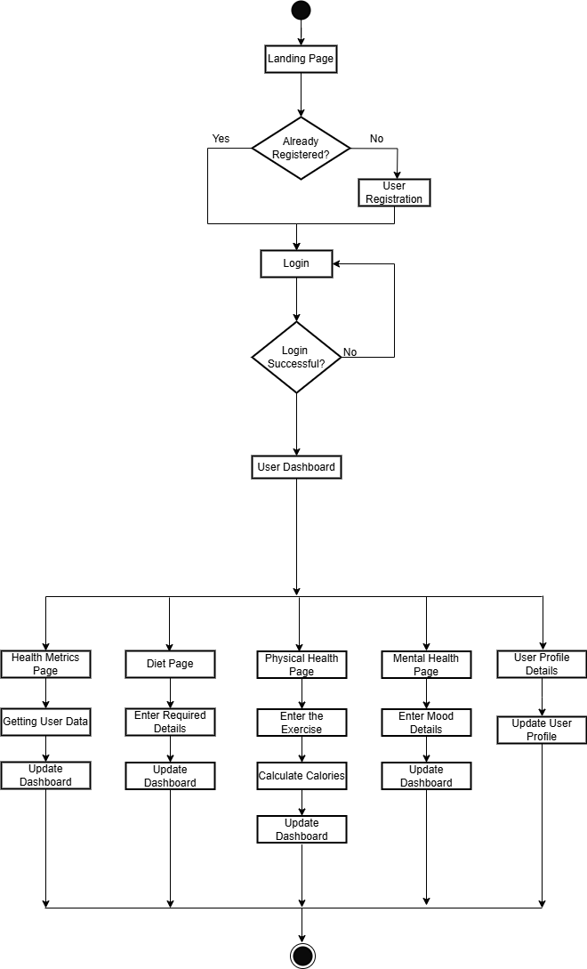

Flow Chart:

Slide 8
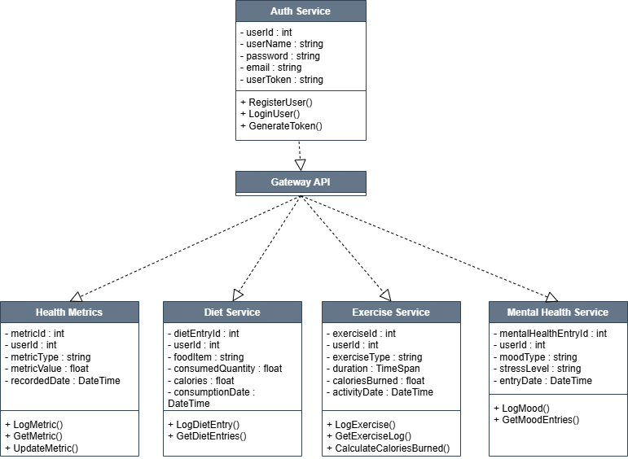
Class Diagram:

Slide 9

Technology Stack Overview
Backend
ASP.NET Core (Web API)
Frontend
Angular 18
Database
SQL Server

Slide 10
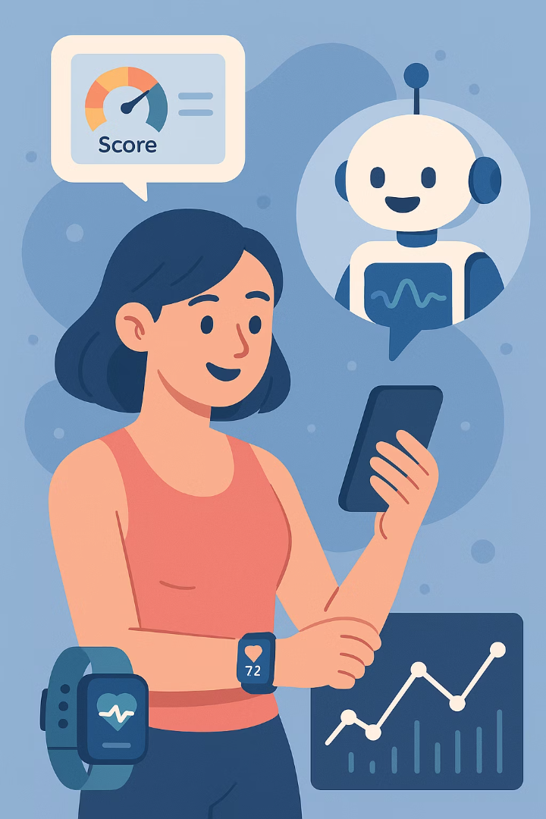
Future Enhancements
Provide a user focused recommendation AI Powerd Chatbot
Using an Algorithm that gives Holistic score to the user as feedback
Utilize fitness devices to automatically collect data instead of relying on manual entries

Slide 11
Thank You

